Slide 1

Application, Interview, and Hiring Workshop
Preparing for upcoming interviews for
Faculty and Academic Management positions

Slide 2
Summary of training session:
1
Prepare to Apply for a position:
Prepare a resume, write a teaching philosophy (if applicable), gather your personal and professional references, obtain an unofficial copy of transcripts (if applicable), collect letter of recommendations, create an account in NeoGov and upload information.
4
Interview Preparation:
Do you need a reasonable accommodation? What to prepare for prior to your interview day- teaching demonstrations, presentations or writing exercises.
2
Job Announcement:
Understanding the Job posting, minimum and desired qualifications, deadline dates, ensure you do not need equivalency (if you do, fill out separate form), verify all required material before hitting submit. Don’t forget to check your email and NeoGov for active notifications.
5
1st and 2nd Level Interviews:
Get an inside look at both the first- and second-level interview processes. Sample questions, the importance of answering multi-part prompts, and what to expect when you arrive. Understanding the committee makeup/role, and how the interview rubric and ranking works on KSA’s.
3
Screening job applications:
HR Generalist- how an application is screened based off minimum qualifications and desired qualifications.
6
Tips for successfully interviewing:
Do’s and Don'ts and next steps.

Slide 3
HR’s Recruitment Process:
Vacancy or Position Established:
PRF is submitted to the Office of Human Resources.
HR Generalist will reach out to the hiring manager to obtain information for the job announcement.
Job Announcement:
Position will be posted internally for employees within unit for ten (10) days (if applicable).
Posting will be posted to public via NeoEd for thirty (30) days to establish a large pool of applicants.
The Adverse Impact tool will be utilized during all stages.

Slide 4
What we aim to achieve during recruitment :
Eliminate Bias:
Qualitative & Quantitative
By incorporating both qualitative and quantitative measures and applying adverse impact analysis at each stage of the recruitment process, we can more effectively evaluate candidates and advance our EEO goals.
Unbiased interview process
Screening & interviewing without identifying information
Based solely on job-related criteria (KSA’s); and designed to avoid an adverse impact.
The role of workforce diversity in enriching educational environments.
Eliminate Artificial Barriers:
Eliminates the artificial barrier of “groupthink” and instead focuses on the candidate’s competencies.

Slide 5
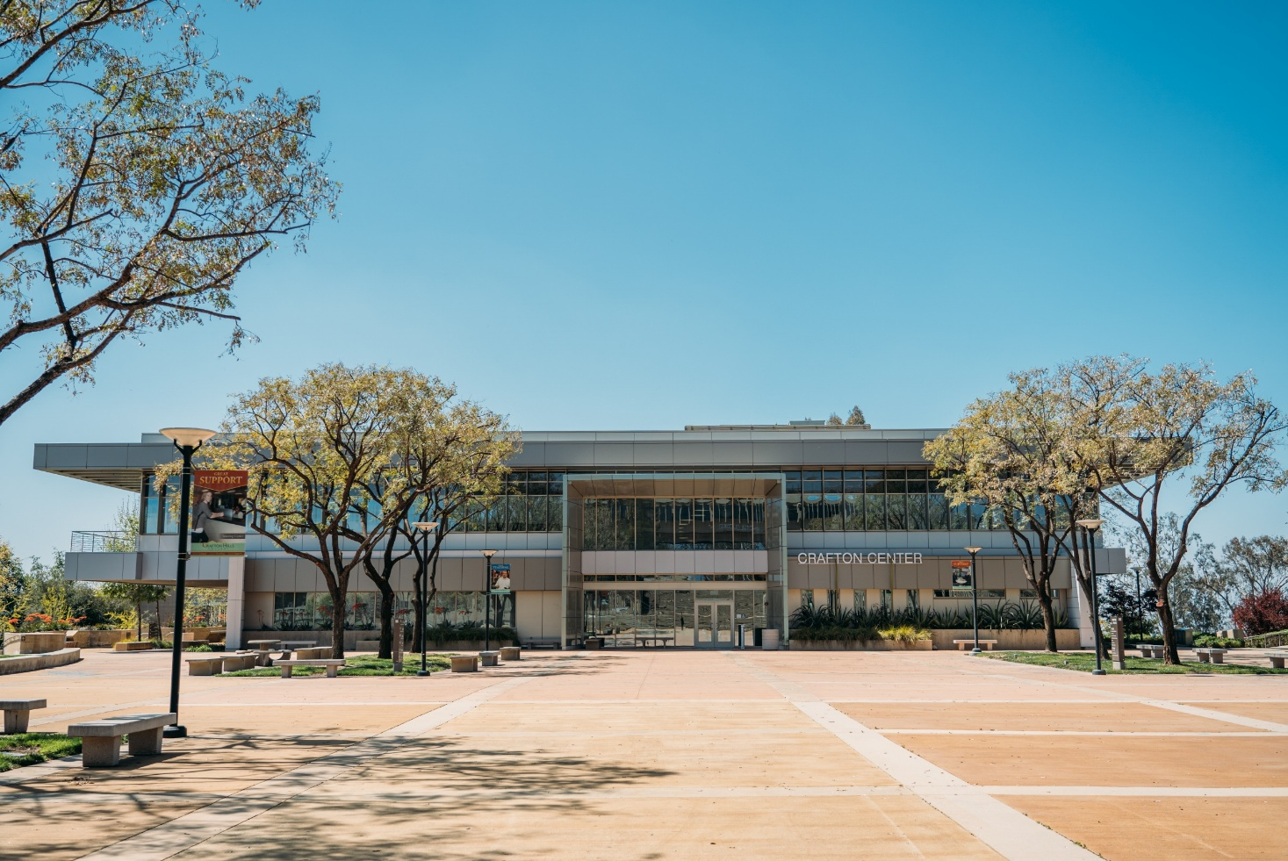
Prepare to Apply for a position:
Build a Strong Application Packet.
Update Your Resume/CV
Write a Teaching Philosophy (if required)
Gather References: Identify 3–5 professional and personal references
Obtain Unofficial Transcripts (if applicable)
Collect Letters of Recommendation
Set Up a NeoGov Account
Tips for Success:
Start preparing materials before the job is posted to avoid last-minute stress.
Review the job description closely and tailor your documents to align with required qualifications and desired competencies.
Keep digital copies of all materials in a single organized folder for easy uploading.
Proofread everything and consider having a colleague review your materials for clarity and professionalism.
If you’re reapplying for multiple positions, update your materials each time to reflect the specific role.

Slide 6

Job Announcement: What to know before you apply!
Read the Posting Carefully.
Understand the Position
Check that you meet Minimum Qualifications
Review Desired Qualifications
Equivalency Requirements
Before You Submit:
Confirm All Required Materials
Keep an eye on the closing deadline
Stay Informed
Tips for Success:
Print or save the job posting for reference while preparing your application.
If you’re unsure whether you meet minimum qualifications, reach out to Human Resources prior to close of posting.
Submitting early helps avoid technical issues or last-minute mistakes.

Slide 7
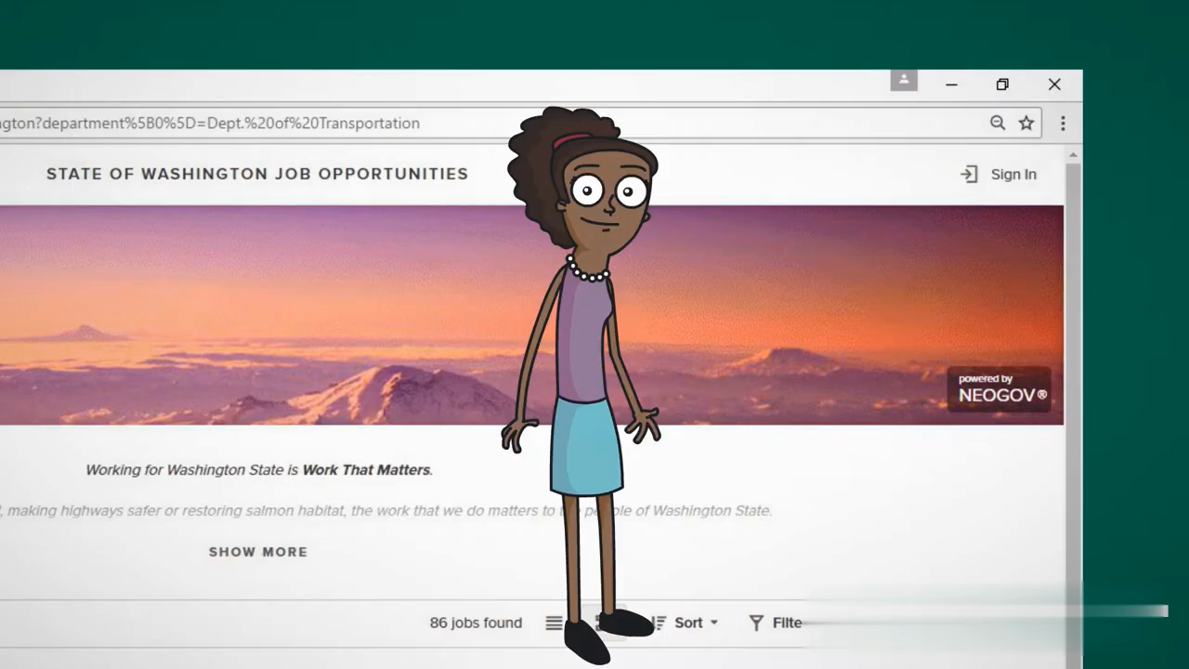
How To:
Create an Account in NeoGov
Go to the NeoGov application portal.
Click “Sign In” and then select “Create Account.”
Enter your email address, create a password, and complete the required profile information.
Once your account is created, you can start applying for positions.
Upload Documents
After logging into NeoGov, navigate to the “My Profile” or “Documents” section.
Click “Upload” and select the files you want to include (such as your resume, transcripts, or letters of recommendation).
Make sure the documents are in the correct format (PDF is recommended) and clearly labeled.
Fill Out Equivalency Forms (if applicable)
Review the minimum qualifications listed in the job posting.
If you do not meet them exactly, complete the Equivalency Form available in the application portal.
Provide detailed information about your education, work experience, training, or coursework that demonstrates you meet the required qualifications.
Upload any supporting documentation (such as transcripts or work experience verification) before submitting.
Important Links:
SBCCD Career Opportunities: https://www.schooljobs.com/careers/sbccd
NeoGov: https://login.neogov.com/Signin
Equivalency Forms & Process: https://sbccd.edu/district-services/human-resources/human-resources-forms.php
NeoGov Customer Service: (855) 524-5627
HR Support: (909) 388-6950 or humanresources@sbccd.edu

Slide 8

Screening Job Applications:
How Applications Are Reviewed and once the posting is closed:
Initial Review by HR
Minimum Qualifications
Equivalency Review (if applicable)
Desired Qualifications (DQ’s)
Tips for a Strong Application:
Clearly show how you meet each minimum qualification in your resume and application responses.
Use specific examples to demonstrate your teaching experience, skills, and achievements that align with desired qualifications.
Double-check that your transcripts, letters, and any required forms are complete and uploaded before submitting.
Remember that incomplete applications or missing documents are screened out automatically.

Slide 9
1st and 2nd Level Interviews:
What to Expect on the Day Of:
First-Level Interview:
Written Exercise (if applicable)
Review of Interview Questions
Presentation (if applicable)
Steps during the interview
Hiring Committee Makeup
Second-Level Interview:
HR Communication to the candidate
Committee Makeup
Process

Slide 10

Interview Preparation:
Before the Interview:
Request Accommodations (if needed)
Review the Job Posting
Research the Institution
What to Prepare For:
Teaching Demonstration/ Presentation
Writing Exercise

Slide 11

Mental Preparation:
Knowledge of position & organization
Practice a mock interview
Prepare any questions you have for the interview panel.
In the Interview:
Introduce yourself confidently.
Maintain eye contact.
Answering Multi-Part Prompts.
Listen carefully and take notes if needed.
Use specific examples from your experience to demonstrate knowledge, skills, and abilities (KSAs).
Never assume the interviewer is a subject matter expert. Don’t use abbreviations!
Interview Tips:
Situational Knowledge:
Thoroughly read through the details regarding your interview prior to your interview day.
Arrive early! Prepare for parking!
Plan to not be in a rush, interviews may be behind schedule.
Physical Preparation:
Dress for success

Slide 12
Interview Question Samples:
*Please note, these questions are samples and are not used in active recruitments.
Please share your background and experience that have prepared you for the position of Assistant Professor, XXX.
What instructional techniques and strategies have you found most effective in the classroom and laboratory settings?
How might you adapt your teaching approach to meet the needs of a diverse student population?
What technologies do you employ in your classes? Describe how these technologies enhance student learning and engagement in both onsite and online classrooms.
Tell us about a time you disagreed with a colleague regarding a teaching or learning approach. How did you handle the situation?
The California Community Colleges Chancellor’s Office has mandated that all colleges address and eliminate equity gaps in educational attainment, with particular attention to Black and Latinx students. How will you integrate strategies to address this in your instructional environment?
How would you manage the diverse interests of classified staff, faculty, and bargaining units within your division? How would you advocate for faculty and staff?
What ideas do you have for adjusting your teaching style to accommodate different learning styles and abilities in the classroom?
Is there any additional information you would like to share with the committee that would assist us in making our recommendation? Do you have any questions for the committee?

Slide 13
Written or Teaching Demonstration Sample:
Writing Assignment Time Limit: 10 minutes
Scenario: You receive an email from a student explaining that, due to family and work obligations, they have missed several coursework deadlines. Your syllabus clearly states that due dates are firm. In the email, the student acknowledges difficulty understanding key course concepts but expresses a sincere desire to catch up. They are requesting an extension on their submissions and additional help to improve their comprehension of the material.
Prompt: Please draft a written response to the student. Your reply should demonstrate professionalism, empathy, and adherence to course policies while also reflecting your approach to supporting student success.
Chemistry Professor Teaching Demonstration Prompt:
Time Limit: 15 minutes
Scenario: Prepare and deliver a 15-minute lecture introducing organic functional groups and their importance in biological and industrial chemistry. Your presentation should include clear explanations and relevant examples that connect to everyday materials or real-world applications. You may interact with the hiring committee as if they are students.
Instructions: You may use any instructional method or teaching format you prefer, such as PowerPoint, Canvas, visual aids, lab demonstrations, handouts, or other creative approaches. The goal is to demonstrate your ability to engage students, communicate complex scientific concepts clearly, and connect the material to practical and relatable examples.

Slide 14
Mock interviews are available upon request on a one-on-one basis. Please contact your campus HR Generalist team to schedule.

Slide 15
Questions?
HR Recruitment Services Contacts:
CHC: Ben Dijkstra- bdijkstra@sbccd.edu or Shawna Gibson- sgibson@sbccd.edu
District: Dawn Garcia- djgarcia@sbccd.edu
SBVC: Erica Mosley- emosley@sbccd.edu or Shawna Gibson- sgibson@sbccd.edu
Associate Director, Human Resources, Recruitment, and Employee Information Services:
Stacy Holloway- sholloway@sbccd.edu

